Slide 1
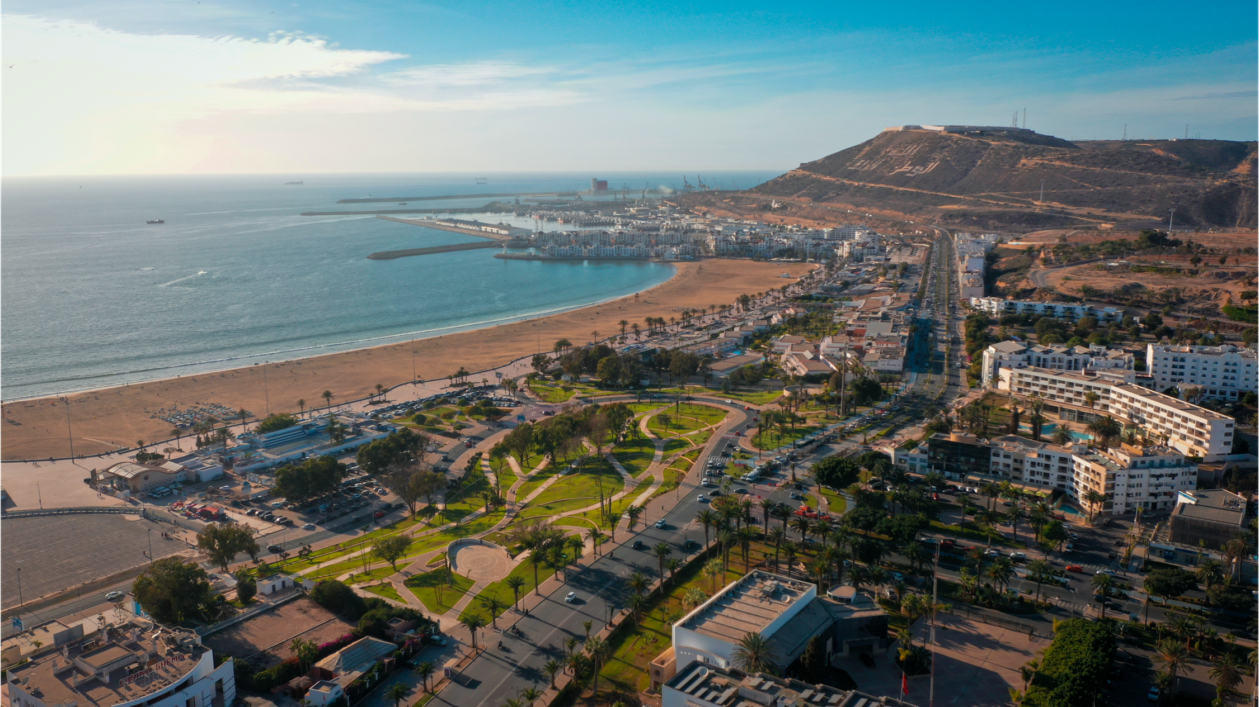















From Intelligence to Technology
From utility to data
Víctor Fernández Morales CEO La Buena Huella

Slide 2



MUCH NOISE, LITTLE FOCUS
What kind of tourist destination do we want to build?
Where do we want to live today? And tomorrow?
We will need to decide, design a plan, implement it,
measure it and be accountable.
What happens when we carry out an action?
What impact does it have? What return does it generate?
Was it worth it?

Slide 3




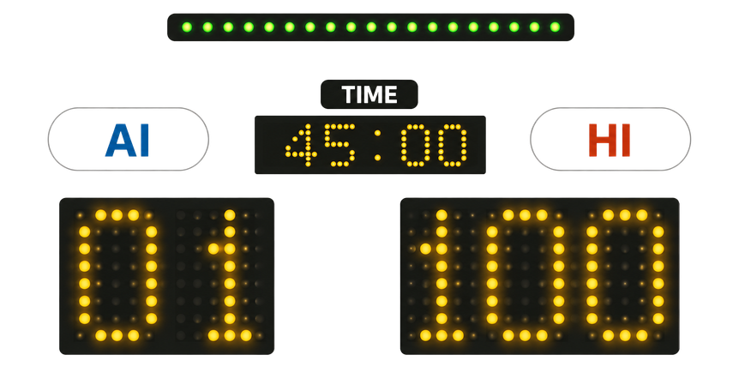
ARTIFICAL INTELLIGENCE vs HUMAN INTELLIGENCE
WHY? Because having the best players does not win the match by itself.
Someone still has to decide the strategy,
read the game, and make the final call.

Slide 4


WHAT DOES AI CONTRIBUTE TO TOURISM MANAGEMENT?
  CAPACITY
  COMPARABILITY
  AUTOMATION OF LOW VALUE PROCESSES
  CONNECTION WITH THE PREFERENCES AND TRENDS OF YOUR SOURCE MARKETS
  TIME TO THINK
  DATA CONSOLIDATION
  VERIFICATION
... AND WHAT DOES NOT?
  STRATEGY
  DECISION MAKING
  CONNECTION WITH STAKEHOLDERS
  CERTAINTY OF SUCCESS
  CONTROL

Slide 5







HOW AI AND HUMAN INTELLIGENCE WORK TOGETHER IN DESTINATION MANAGEMENT
Imagine we want to harmonize tourism flows in Lanzarote, a tourist destination where, with a population of 165,000 people, approximately 3,400,000 visitors arrived in 2025, with around 60% of its territory under some form of environmental protection.
Step 1: Triangulate current movements through mobile signals → AI supported
Step 2: Risk and opportunity analysis. (Identification of niches, preferences, uses, interactions, etc.) → AI and human interpretation
Step 3: Work with inbound and outbound tour operators → Human led
Step 4: Redesign the tourism product, with emphasis on geographical diversification, attractions and offerings → Human led, AI informed
Step 5: Reorganize flows linked to a better destination experience, service quality,
and territorial impact → Human led, AI informed
Step 6: Measure results → AI supported
Step 7: Share results and continue improving → Human led, AI supported

Slide 6










PROJECTION OF IMPACTS: TERRITORIAL, ENVIRONMENTAL AND SOCIAL TRANSFORMATION
  Lower risk of traffic congestion
  Reduced conflict
  Mitigation of tourism-phobia risks
  Cooperation in territorial governance
  Better interaction with the natural environment
  Lower impact on biodiversity
  Lower impact on soil, water, and air
  Better waste management
  Improved experience and uniqueness of the tourist destination
  Greater capacity for the conservation, and the promotion of cultural heritage (tangible and intangible)

Slide 7








... AND RETURNS: ECONOMIC, STRATEGIC, OPERATIONAL AND EXPERIENTAL GAIN
  Higher satisfaction rating
  Higher revenue per visitor
  Opening opportunities for local businesses
  Greater efficiency in resource use
  Greater control over the activity and its outcomes
  Diversify the offer
  Access new markets
  Generate value and create price

Slide 8

CONCLUSION
The best way for Artificial Intelligence to be useful in tourism destination management is to apply intelligence, in general.

Slide 9



Thank you for your attention!
Contact us:
comunicación@labuenahuella.org
www.labuenahuella.org
www.linkedin.com/company/la-buena-huella/

