Slide 1
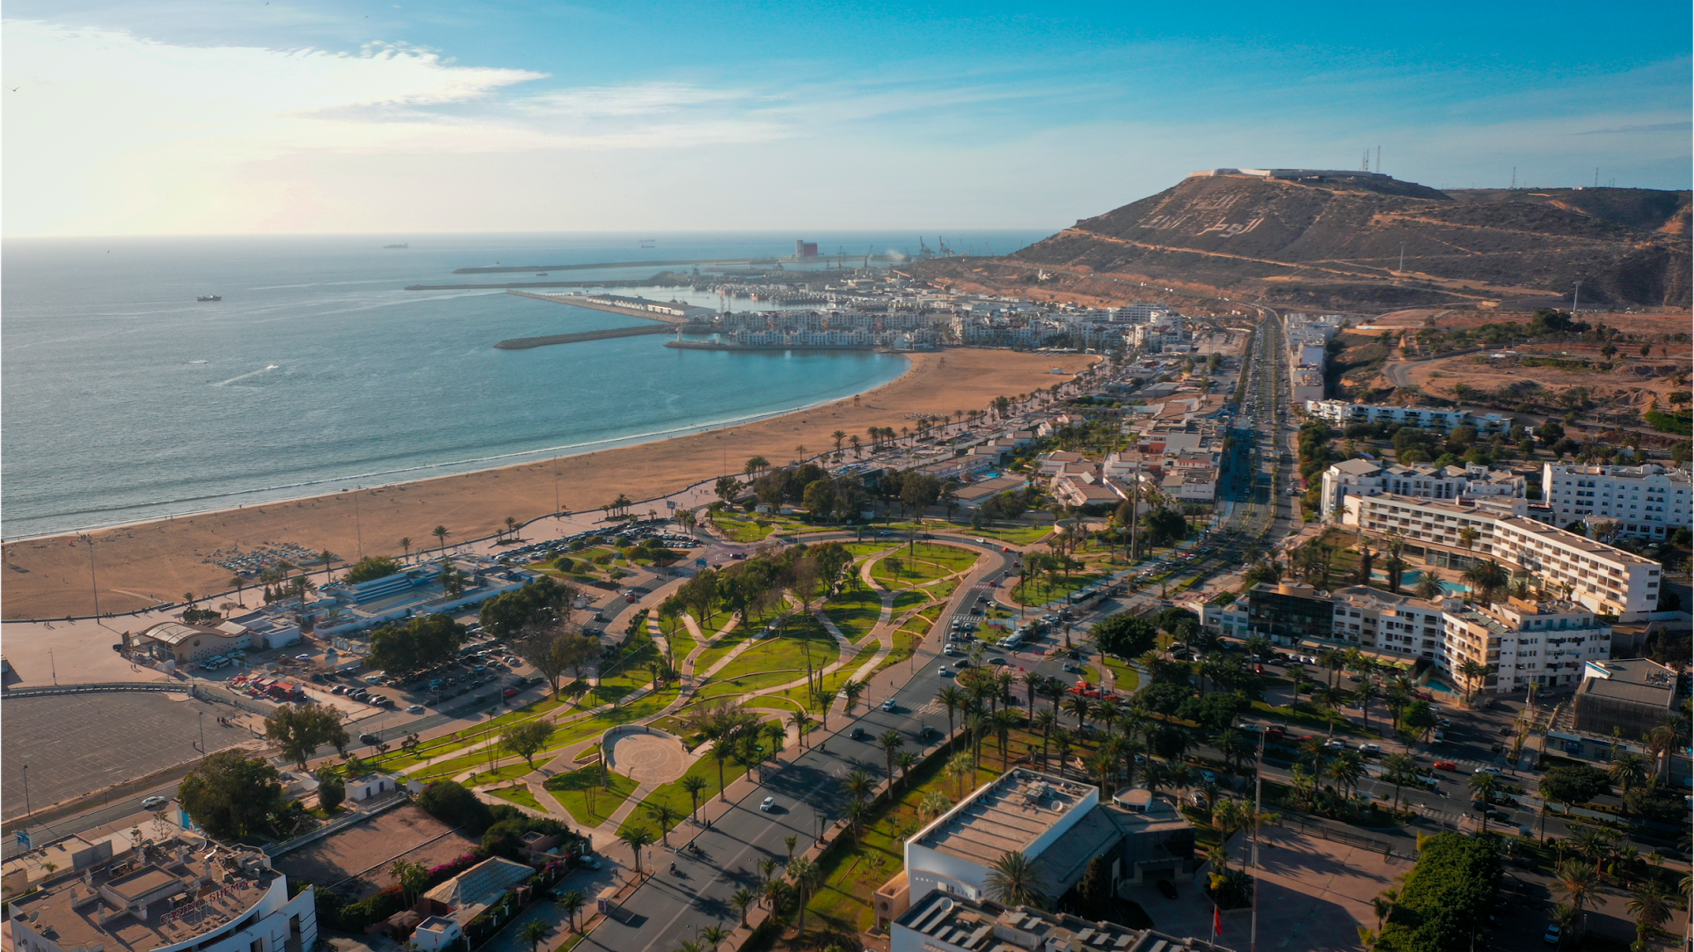















Tourism Intelligence System (TIS)
Turismo de Sevilla
Ana Ramírez Moreno

Slide 2



Smart Tourism Office
Tourism today
Smarter tourism
TOURIST DATA CENTRE
2017
Sustainable
Accessible
Digital
Innovative
Participatory
Studies in pdf format, which were shared with the CEO of CONTURSA, and which are available on the tourism website.
MORE DATA
14 KPIs >>> 122 KPIs
2021
SMART TOURISM OFFICE
Action Line >>
OVERCOMING CHALLENGES
KNOWLEDGE
SHARING
DIGITAL ECOSYSTEM
Data and project integration with city platform.
Our goal
Working on the impact of tourism through enhancing the visitor experience, improving the quality of life of the resident and the competitiveness of businesses.
SMART CITY
SMART TOURISM

Slide 3


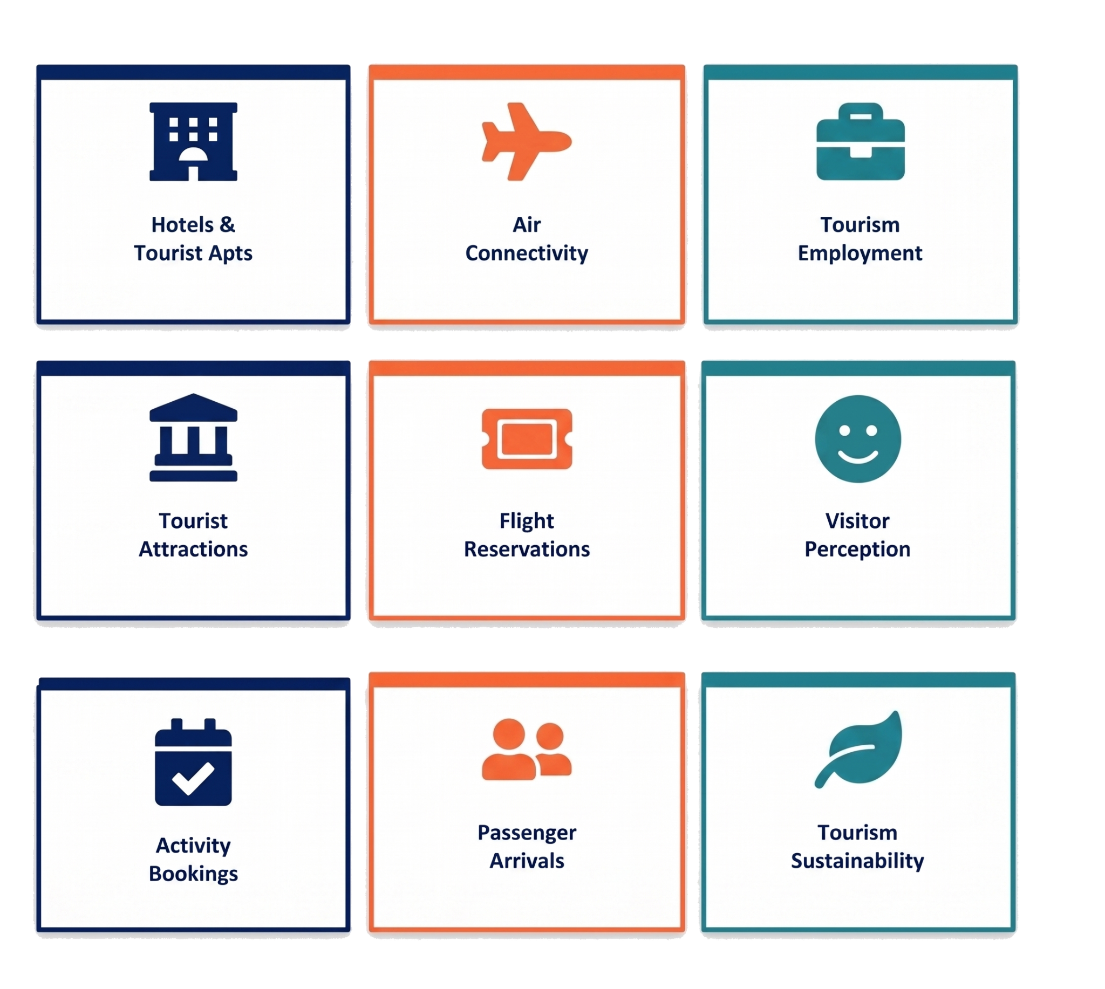


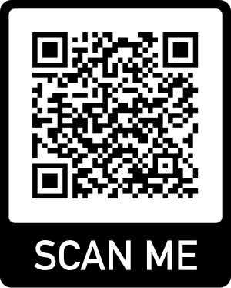
Tourism Intelligence System
Data for decision making
Its mission is to improve strategic planning processes with predictive and diagnostic analytics.
Overtourism
Seasonality
Environmental impact
Challenges
The relationship between tourists and residents

Slide 4
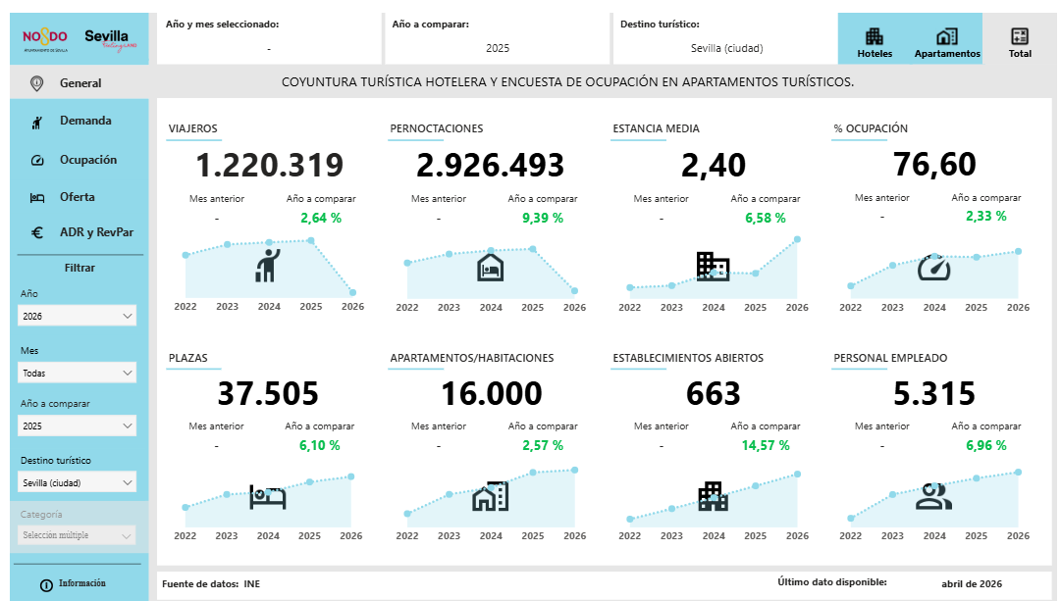
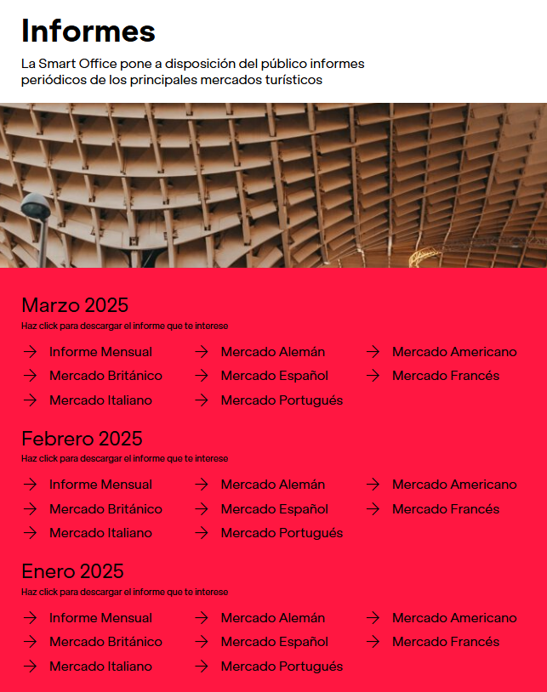
Tourism Intelligence System
Monthly reports on the markets and on the current situation as a whole are published.
These reports include visitors, overnight stays, number of passengers, sustainability, visitor interests,... ensuring stakeholders are informed and capable of adapting strategies as needed.

Slide 5


Merci pour votre attention!
Conctactez moi sur :
aramirez@sevillacityoffice.es
Smart.sevillacityoffice.es
www.linkedin.com/in/anaramirezmoreno/

