Slide 1
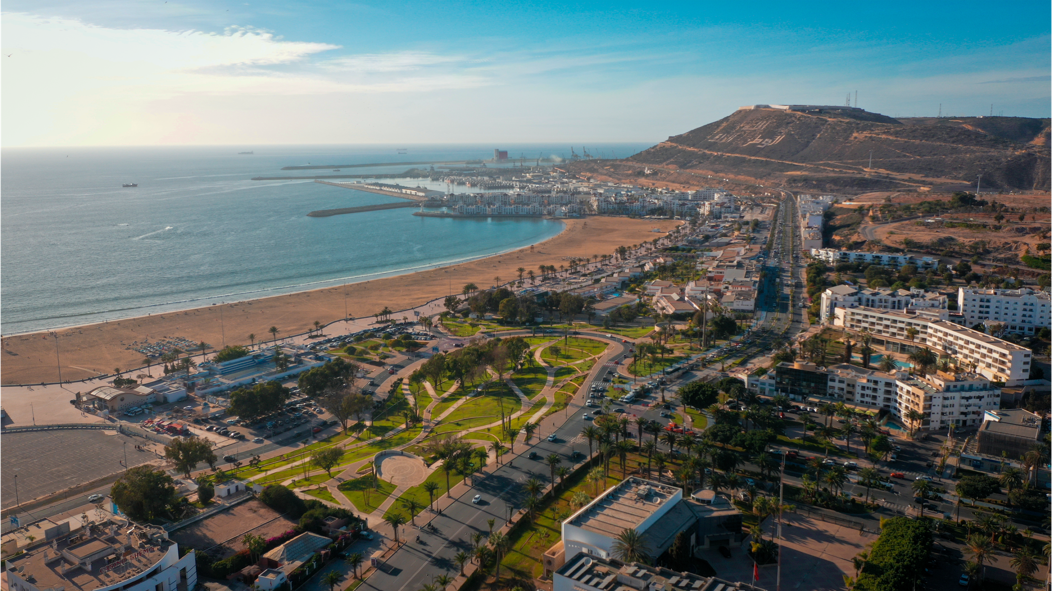















Innovative Blue Tourism
Matteo Bocci

Slide 2

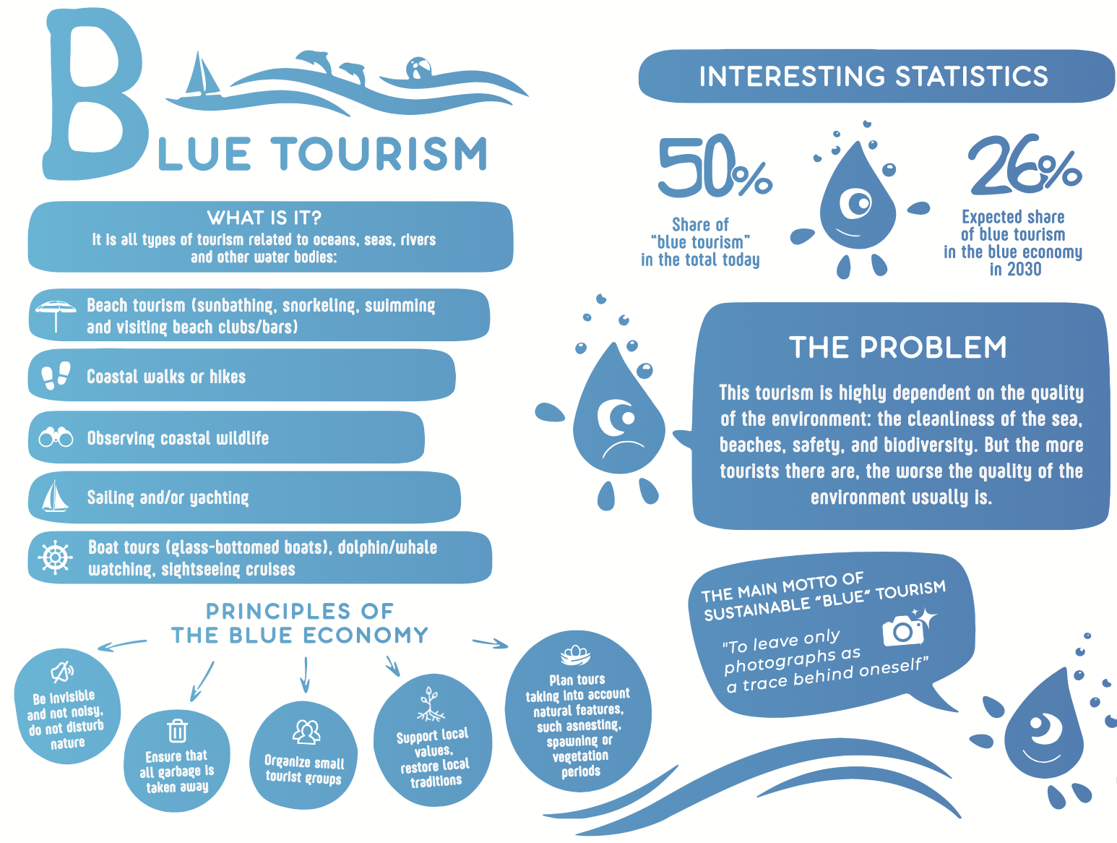

What is blue (coastal, marine and maritime) tourism ?
Limited local added value?

Slide 3
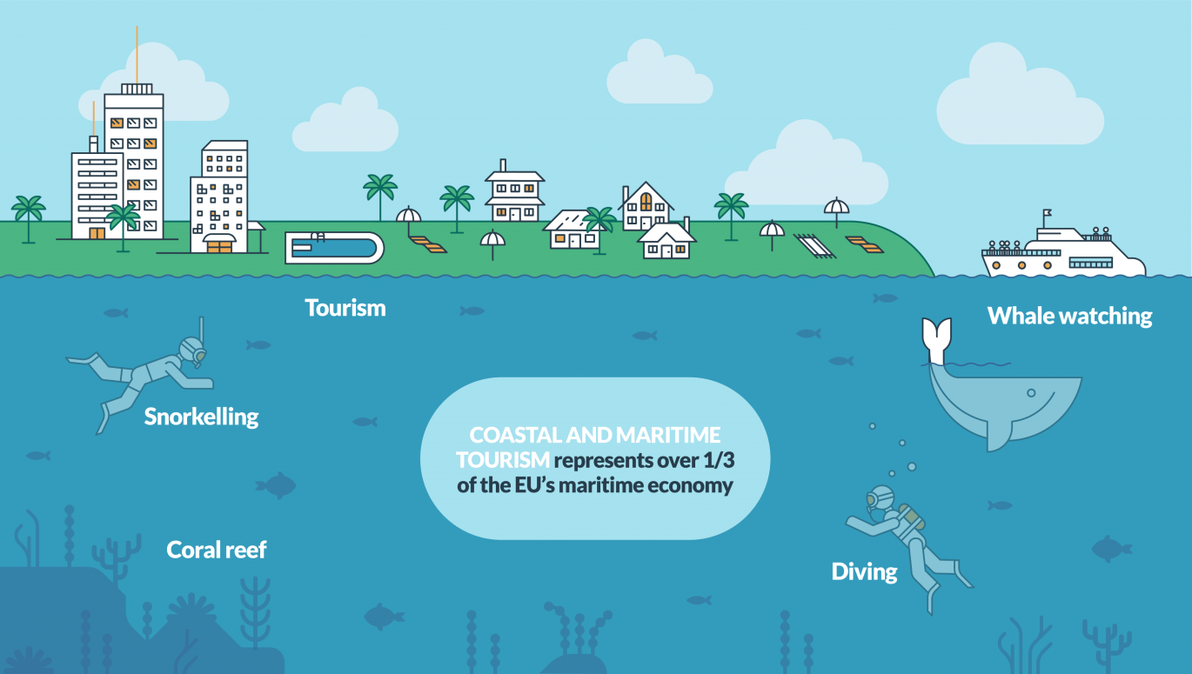
What challenges it faces and opportunities it offers ?
Opportunities: maximise younger, local and international visitors, greater local returs, greater visibility to digital marketing/services
Challenges: develop local entrepreneurship, improve digital uptake of the sector and monitoring

Slide 4
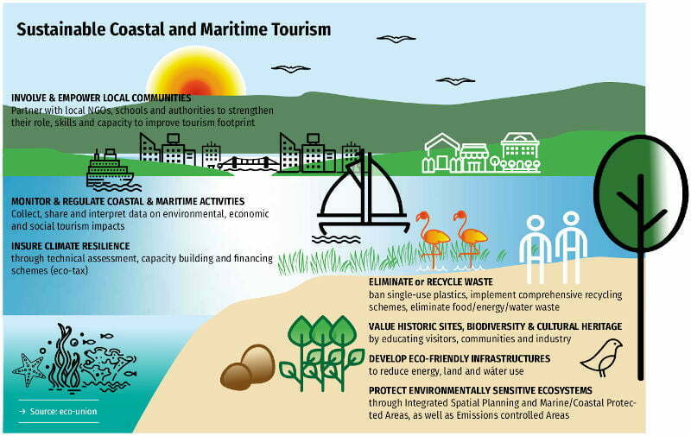
What principles it should reflect ?

Slide 5

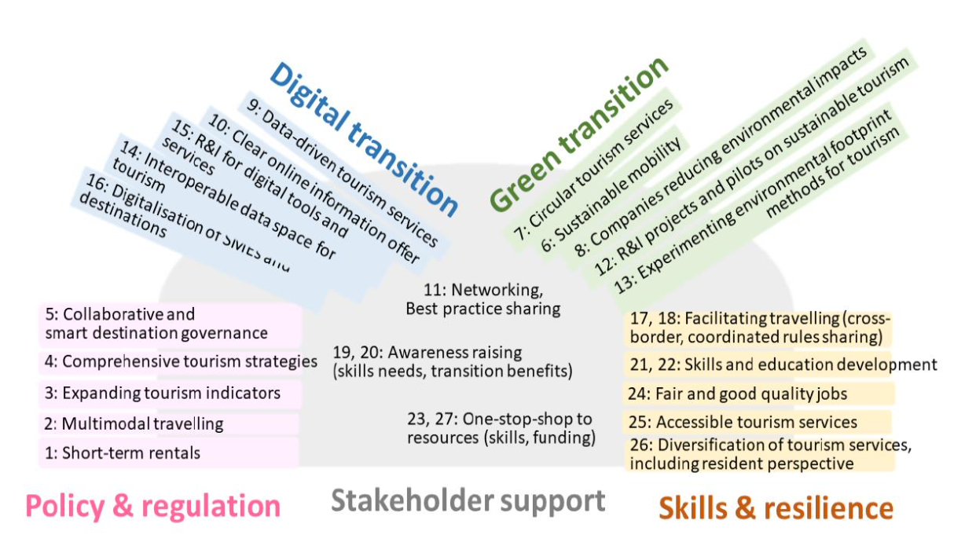
What drivers for blue tourism innovation ?
Infrastructures & Business Models
Approaches & Competences

Slide 6
Transforming value-chains through inter-dependencies
Strengthen the overall complexity and resilience of touristic offers, from cruise, ferry, yachting and sailing markets.
Broader coastal and maritime tourism development and with further linkages towards water sports, gastronomy and fisheries/pesca-tourism.
Streamlining the need for greater protection of local heritage, and local ecosystems (marine, coastal).

Slide 7


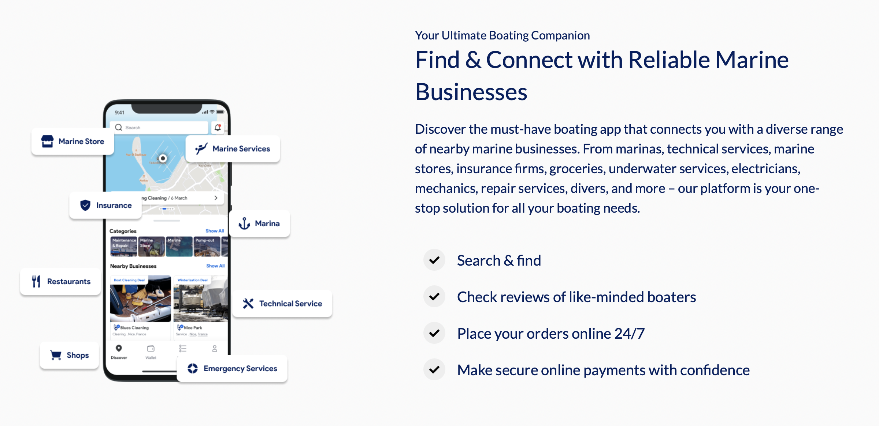
Examples of existing solutions (1 of 3)

Slide 8
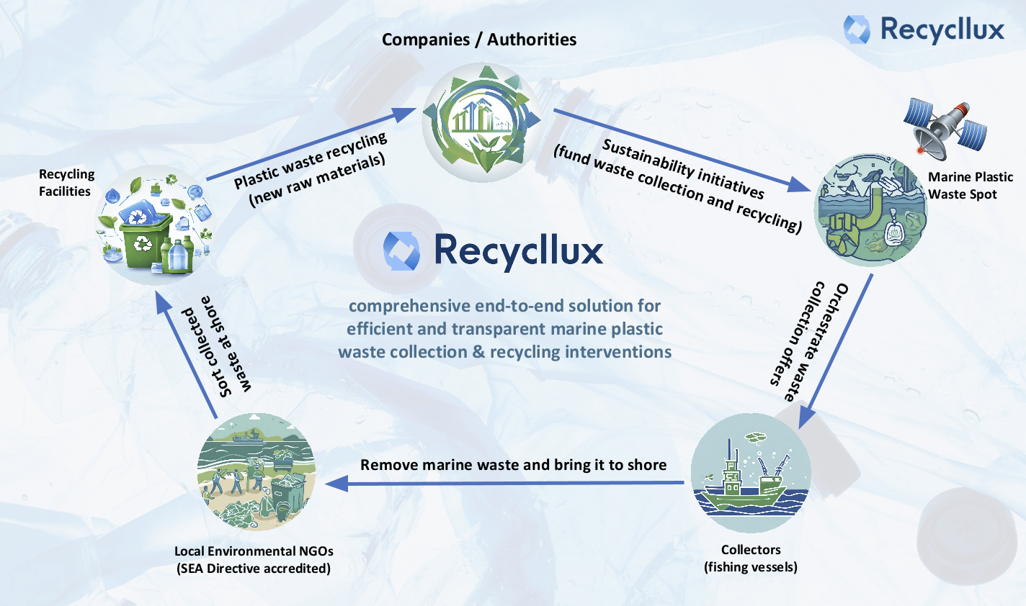
Examples of existing solutions (2 of 3)

Slide 9
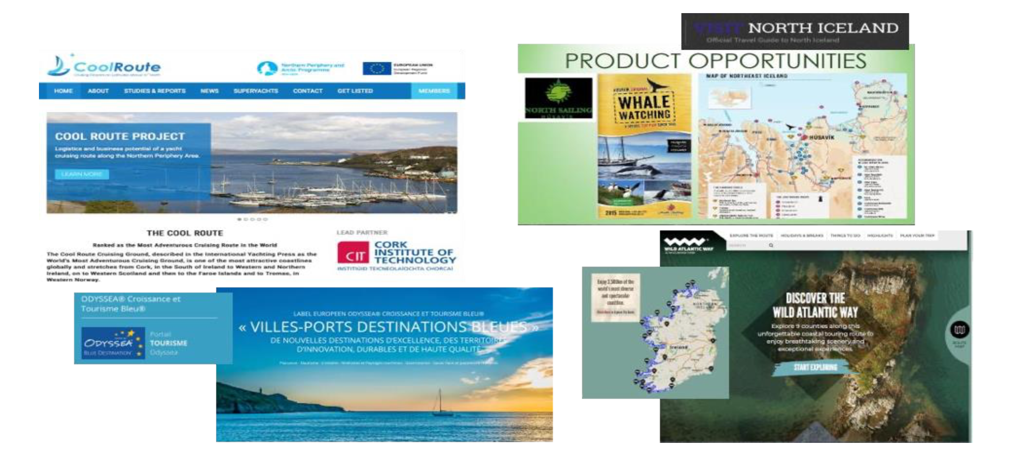
Examples of existing solutions (3 of 3)

Slide 10
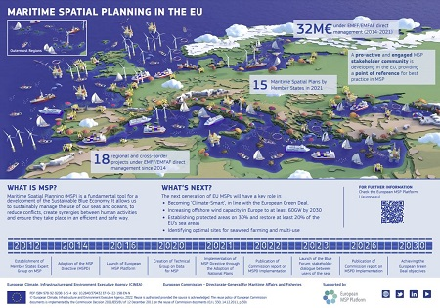
Address conflicts in the use of space

Slide 11
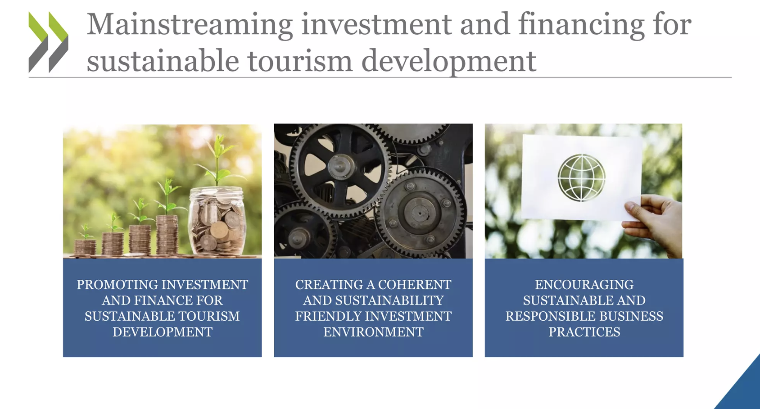
Attreact sustainable investments in the long-terms

Slide 12
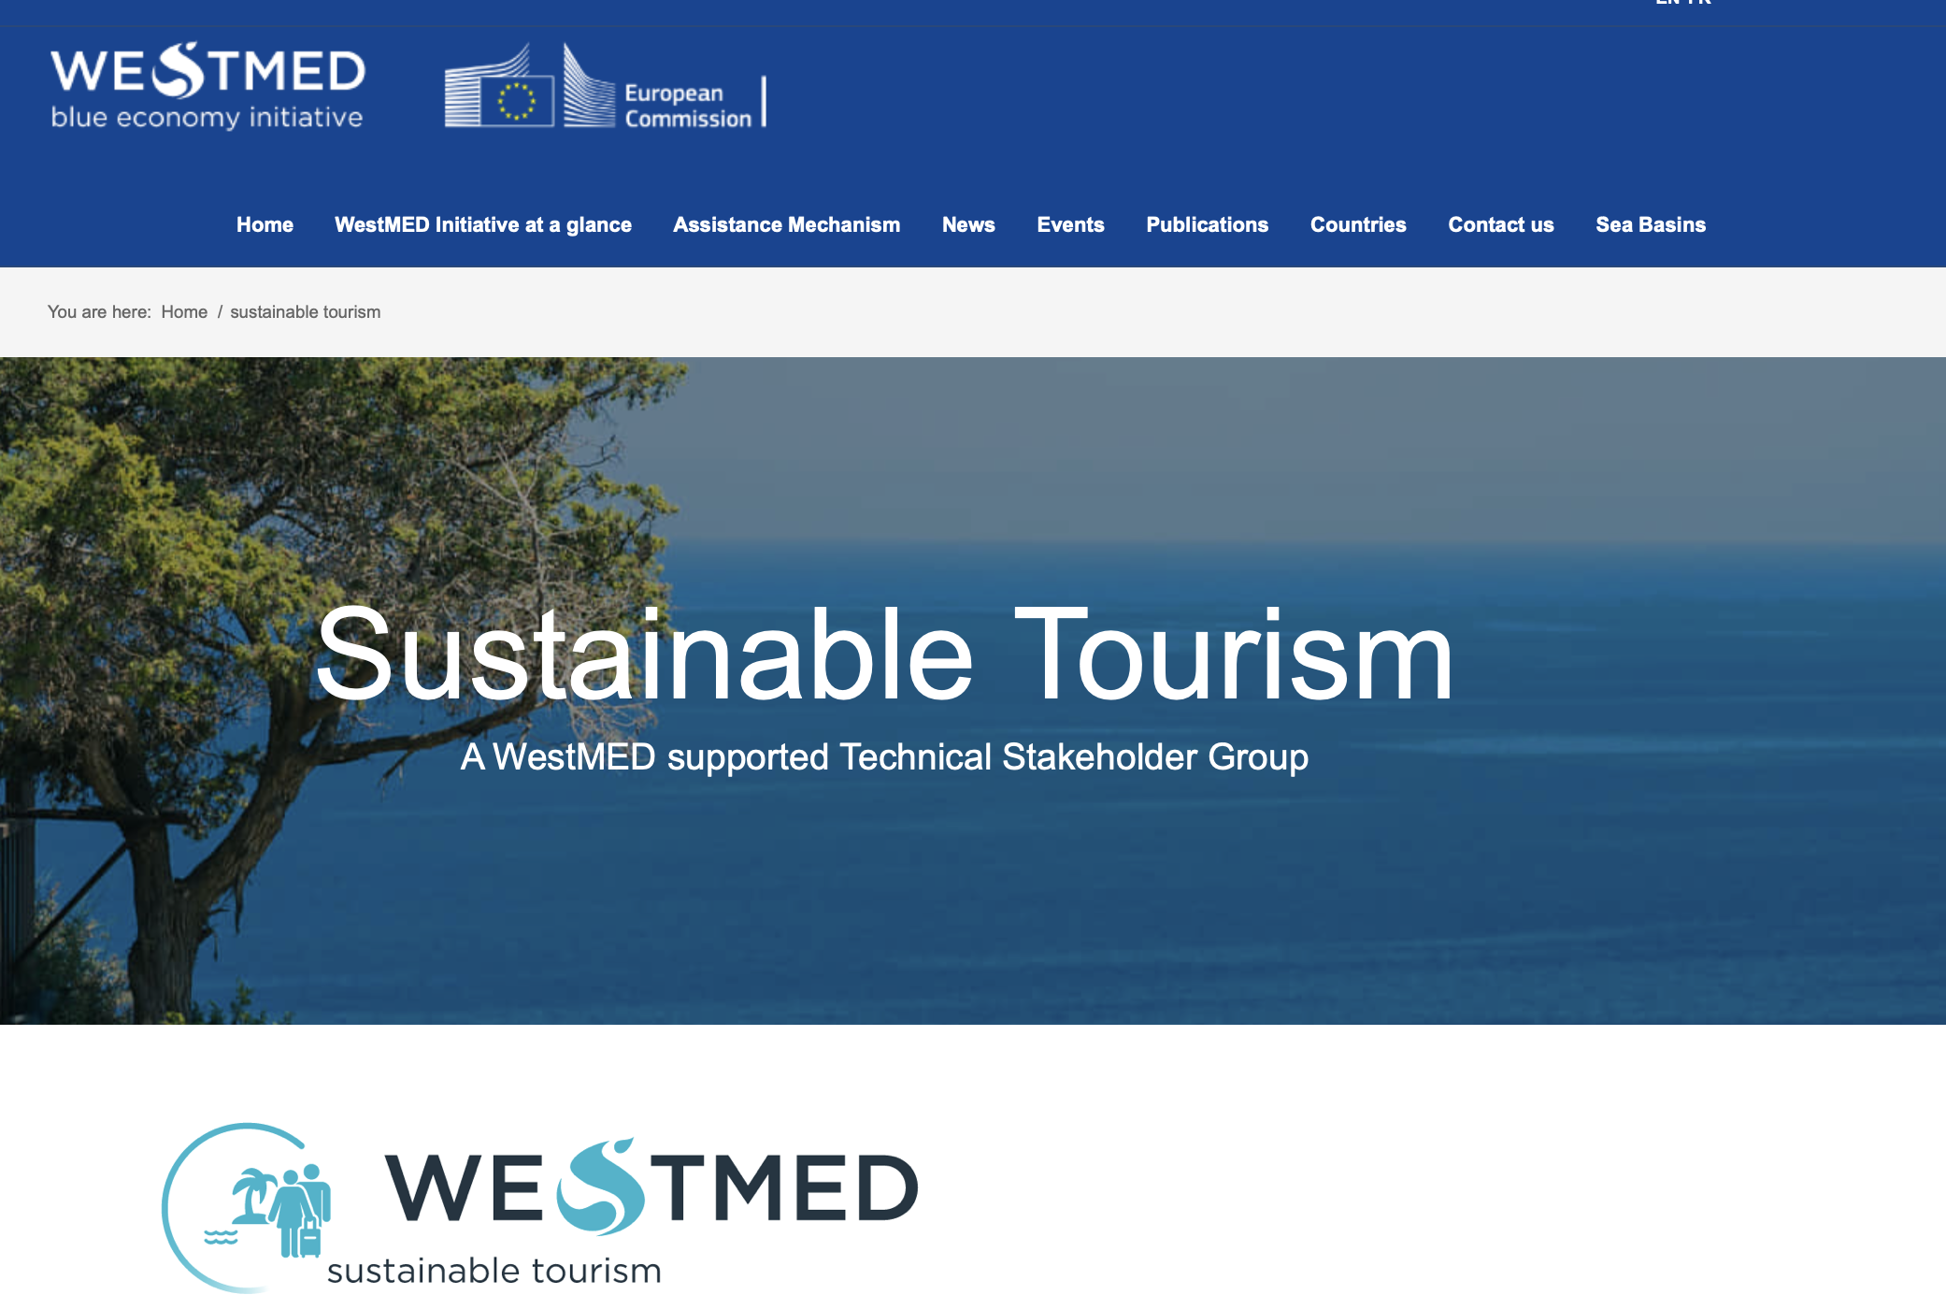
WestMED Initiative: Sustainable Tourism TG
A technical forum to discuss trends and opportunities towards sustainable tourism within the region and to provide support to participants to develop innovative project ideas.
A core group, with national members.
An advisory group, with relevant stakeholders that are also involved in steering various tourism initiatives, networks, funding opportunities, etc.
An expert group, where all other remaining stakeholders from the tourism industry will be invited to take part to develop project ideas and concrete proposals
Officially approved by the members of the WestMED Steering Committee in July 2024

Slide 13


Merci pour votre attention!
Conctactez moi sur :
Bocci.Matteo@Gmail.com
WestMed-Initiative.EC.Europa.EU
linkedin.com/in/matteo-bocci-a6a0551/

