Slide 1
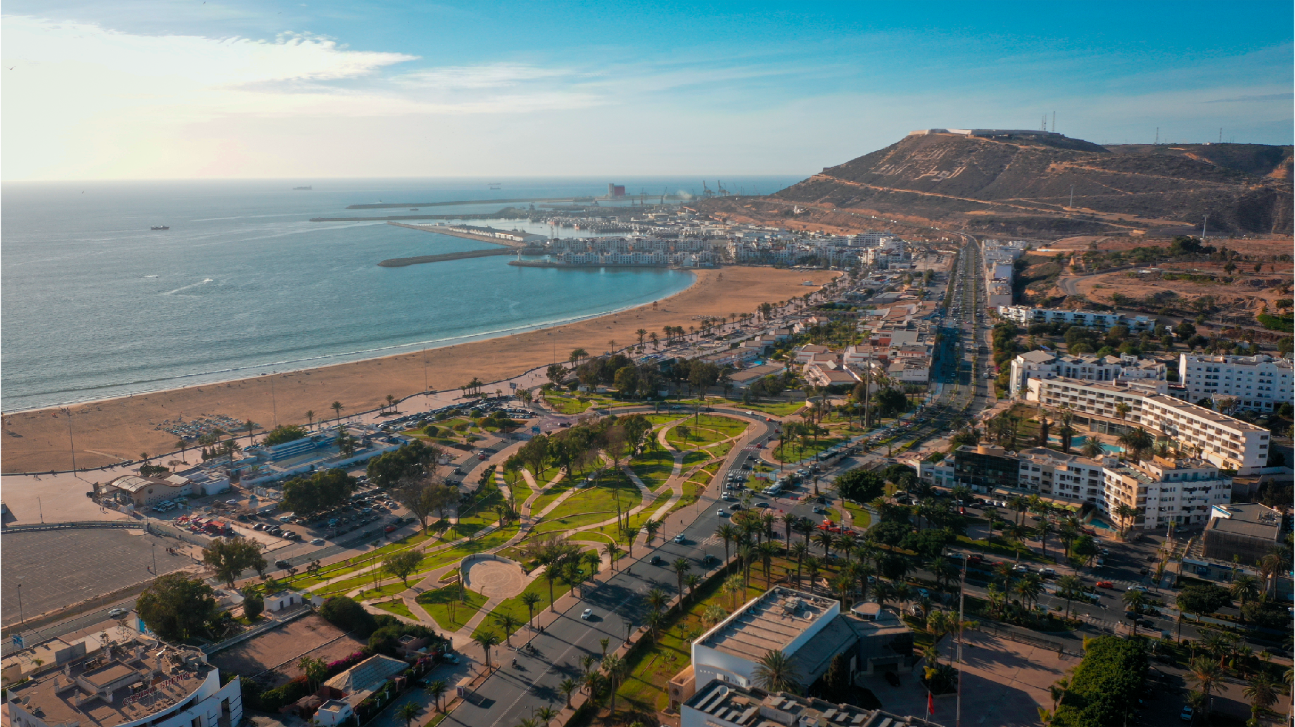



Turning Cruise Calls into Lasting Value for Local Communities
Pol Fages Ramió
President of the Palamós Chamber of Commerce
Chairman of the Tourism Commission of the Catalan Chambers of Commerce

Slide 2


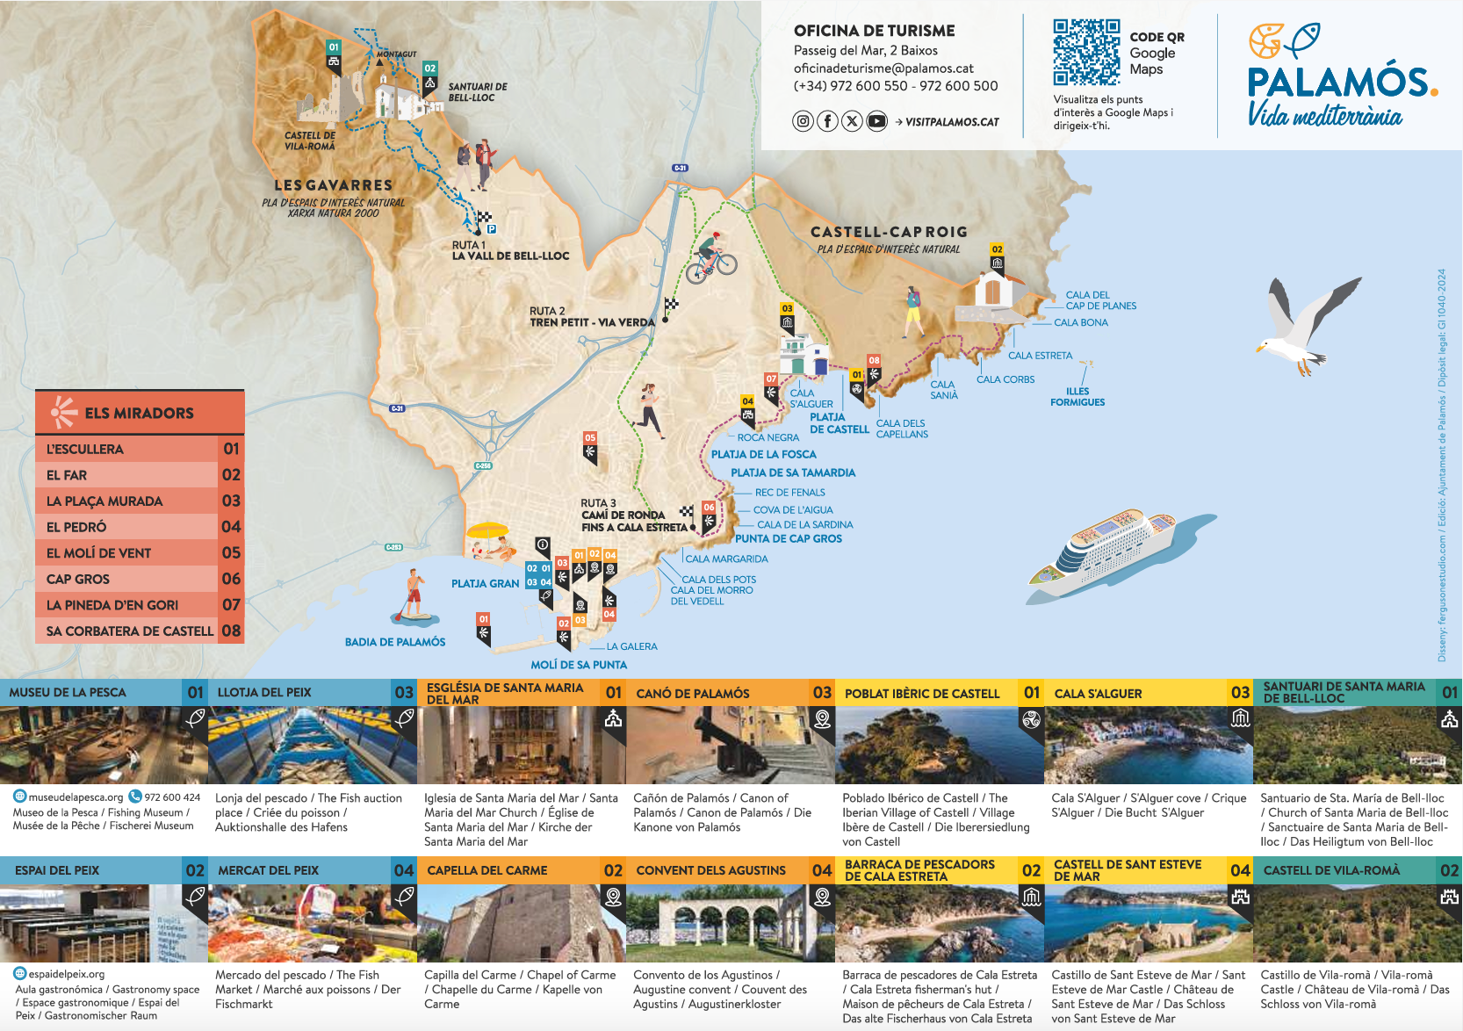
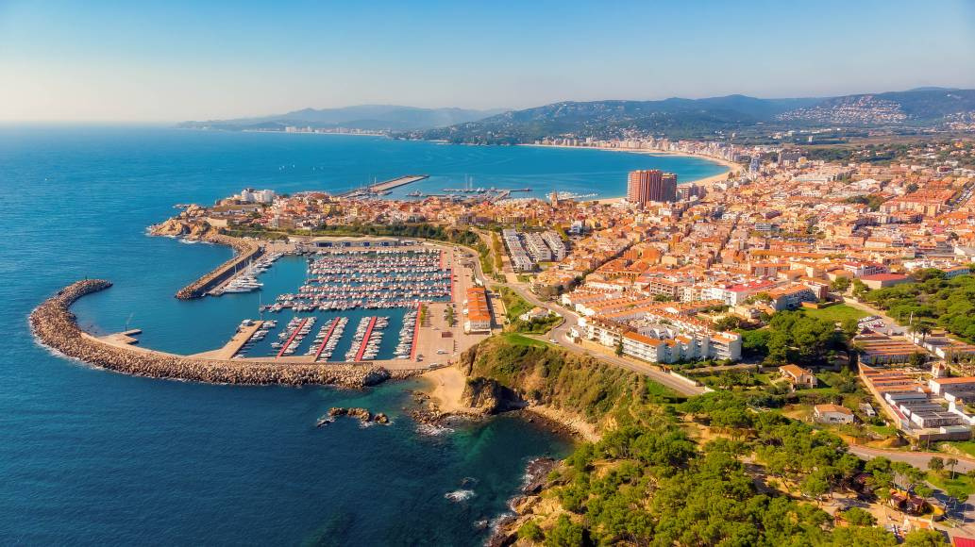
PALAMÓS: A CONNECTED GATEWAY TO THE TERRITORY

Slide 3
Cruise passengers arrive through the port, but they experience the destination through its people
Smart Connectivity for Better Visitor Experiences
- Integrated mobility: port, rail and bus connections
- Reducing friction through seamless information, scheduling and ticketing
- Commitment to sustainable mobility solutions
- Smart management of visitor flows and territorial impacts
- Data-driven decision-making for strategic planning , and help to create
Authentic tourism experiences
The challenge is not to move more tourists, but to move them better.

Slide 4
Cruise tourism is not the destination itself; it is the gateway to discovering the destination.
70 cruise calls and 70,000 passengers (2026)
Activity concentrated in approximately 50 days per year
A port of call model, not a mass tourism destination
Focus on high-value segments
Focus on small-to-medium-sized vessels
Strong territorial redistribution of visitors
Direct connection with local businesses
Creating culture and authentic experiences

Slide 5



presidencia@cambrapalamos.org
polfagesramio@gmail.com
www.cambrapalamos.org
www.cambrescat.org
https://www.linkedin.com/in/pol-fages-ramio/

