Slide 1
iART: Grand events for the Enhancement of Sustainable Tourism in Mediterranean small Villages
Lucenzo Tambuzzo

Slide 2


Village & Rural Tourism in the Mediterranean — Key Data 2020–2024
Small-village and rural tourism is not a marginal niche — it is an accelerating structural shift across the Mediterranean and globally.
INDICATOR | FINDING | SOURCE
+7.4% | Annual growth rate (CAGR) of rural tourism globally 2020–2024, vs 5.1% for overall tourism | Business Research Co. 2024
+63.8% | Growth in attendance at village festivals and local fairs in Italy in 2024 vs 2023 — driven by young people (31%) and families (45%) | ISTAT / Banca d’Italia 2025
51% | Leisure travellers who say experiencing a destination ‘as a local’ is a high priority; 45% concerned they are not having an authentic experience | GetYourGuide 2023
83% | Travellers who consider sustainable travel important (2024), up from 61% in 2021 | Booking.com 2024
89% | Tourism service providers reporting higher demand for experiential and authentic travel | Flyware 2024
$108B | Global rural tourism market size in 2024 (up from $71B in 2020); forecast to reach $115B in 2025 at 7.7% CAGR | Future Market Insights 2025
115% | Rural/village tourism arrivals vs 2019 pre-pandemic baseline — outperforming Mediterranean overall (108%) | UN Tourism Barometer 2024
135% | Morocco’s international arrivals vs 2019 — #1 in Africa; heritage/village share rose from 18% to 31% of arrivals (Chefchaouen, Atlas, medinas) | UN Tourism / WTFI 2024
Sources: UN Tourism World Tourism Barometer 2024 • UNWTO Best Tourism Villages Reports 2021–2024 • ISTAT/Banca d’Italia 2025 • Booking.com Sustainable Travel Report 2024 • Future Market Insights Rural Tourism 2025 • GetYourGuide Survey 2023 • Flyware Experiential Travel Report 2024 • World Tourism Forum Institute 2025

Slide 3

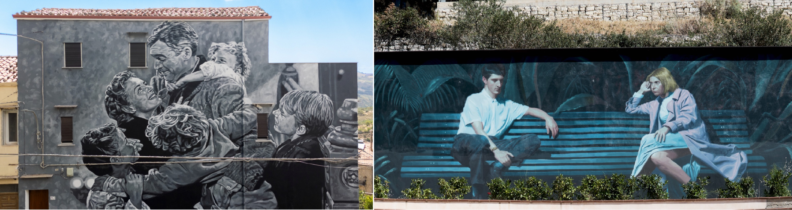
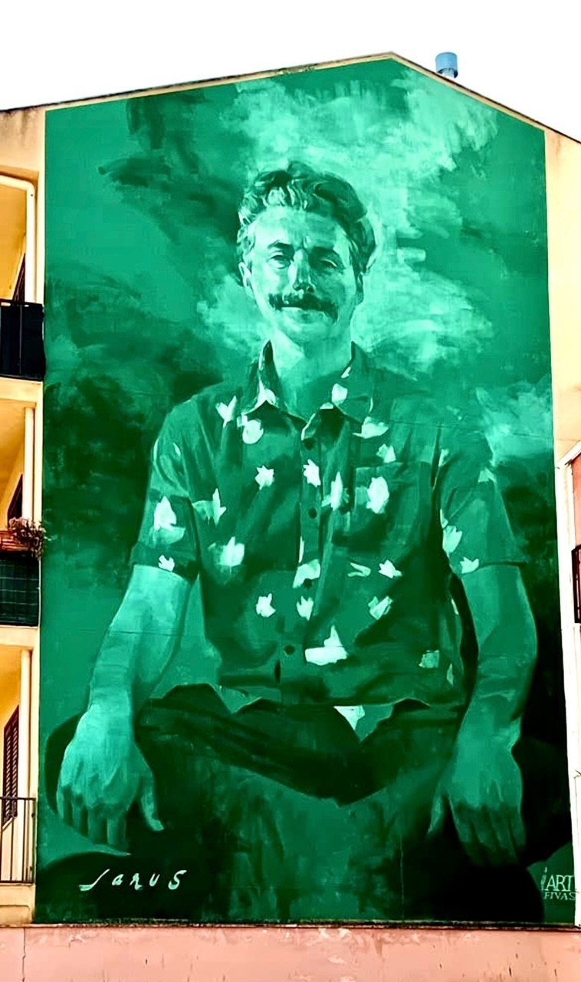
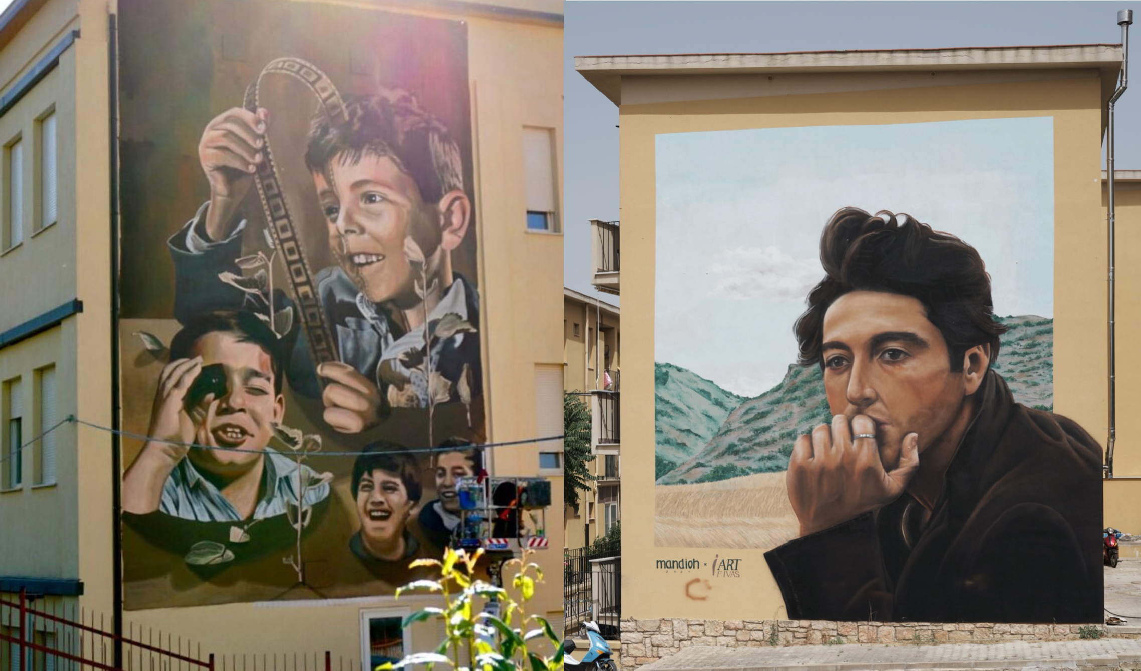
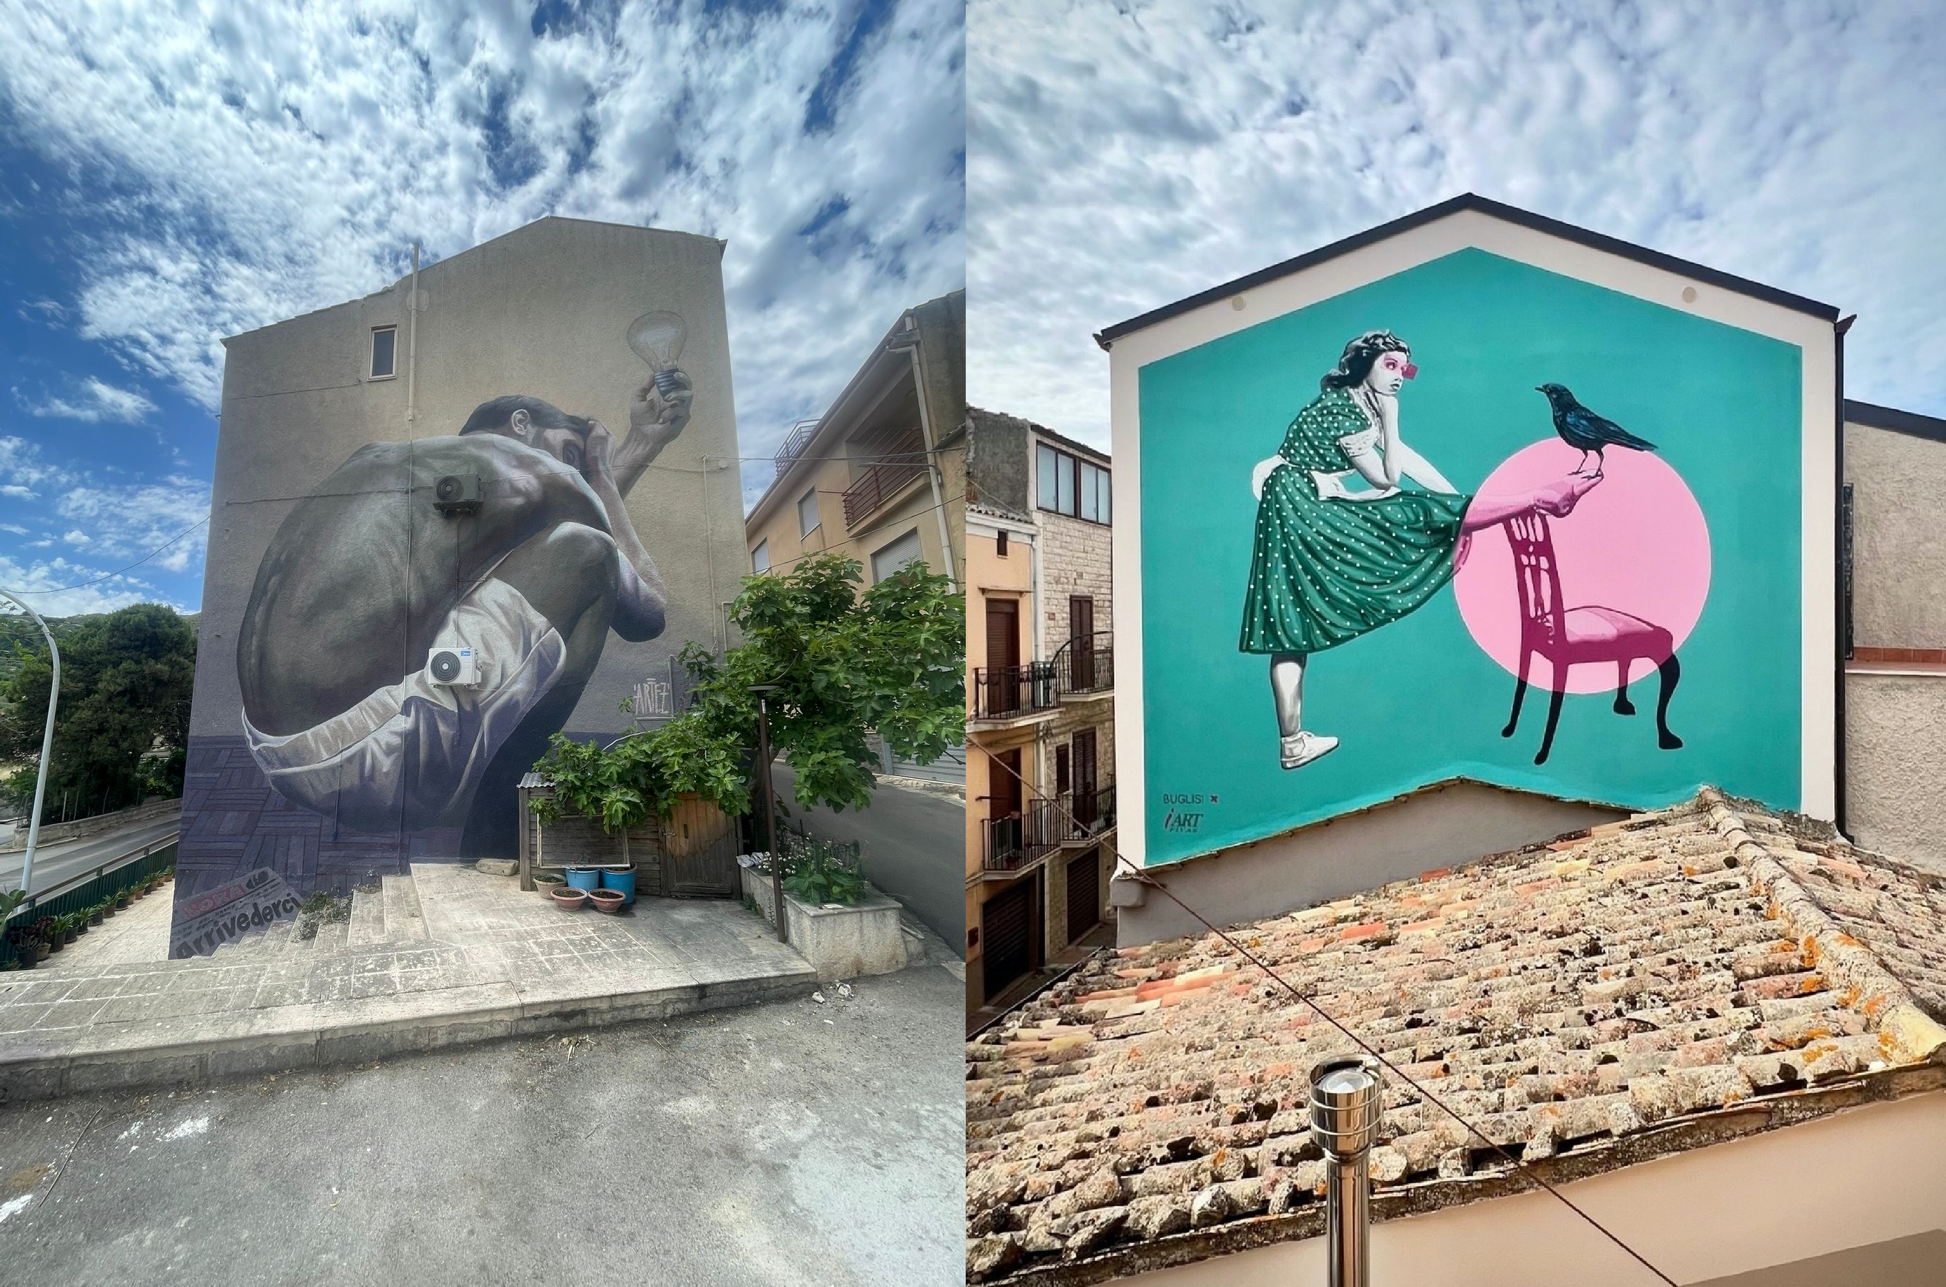
iART: Hollywood in small villages— tourism enhancement and destination attractiveness

Slide 4
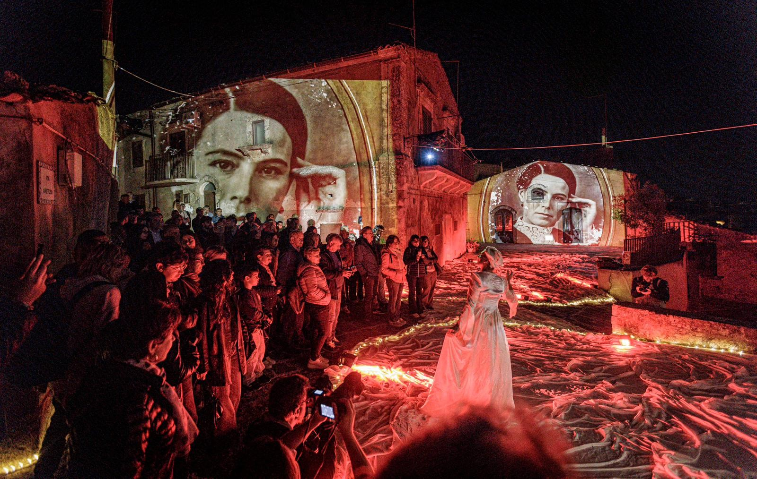
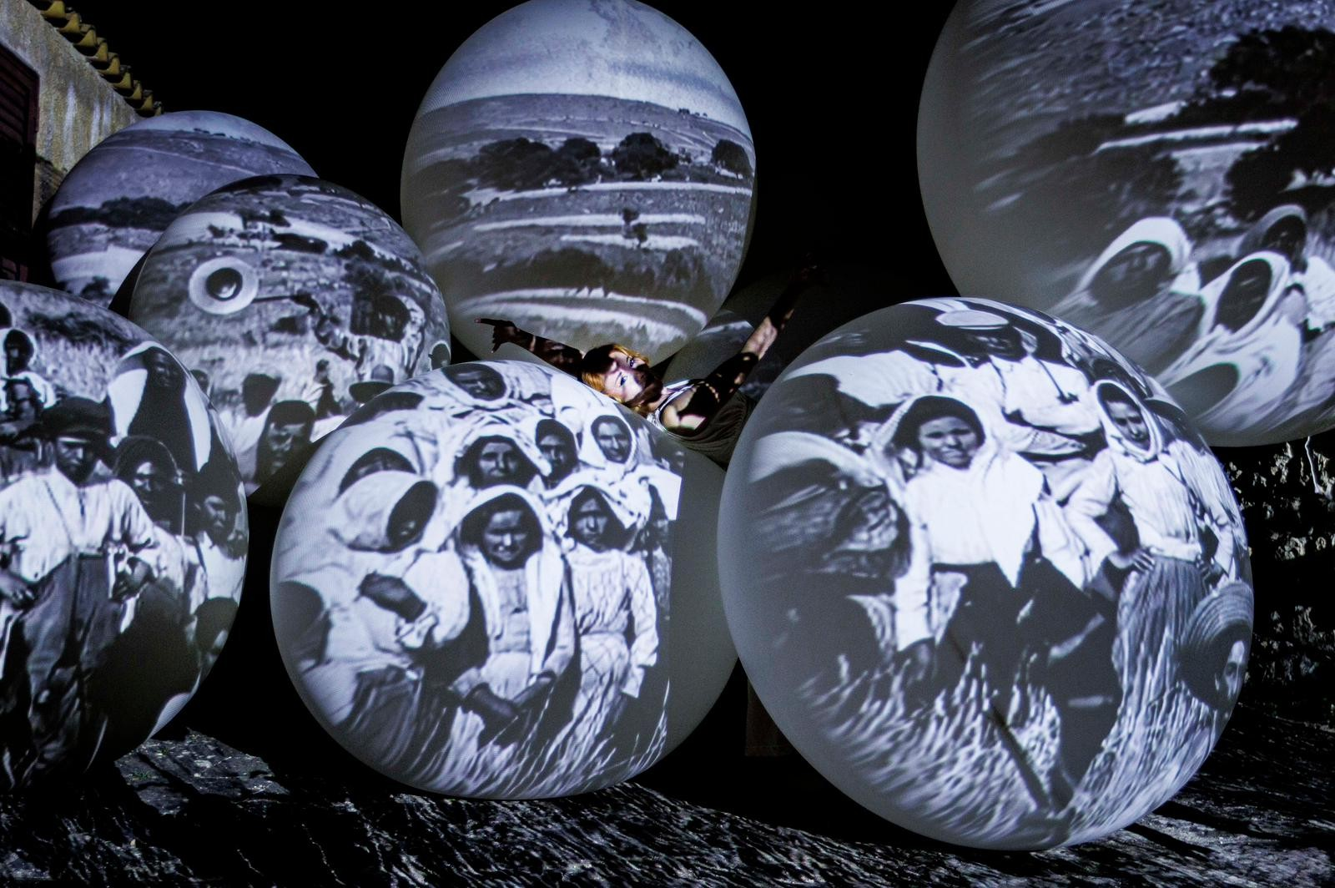
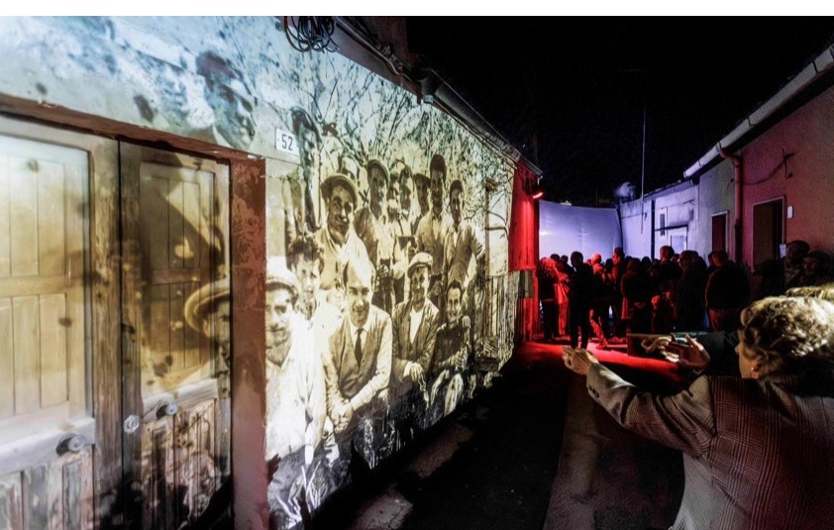
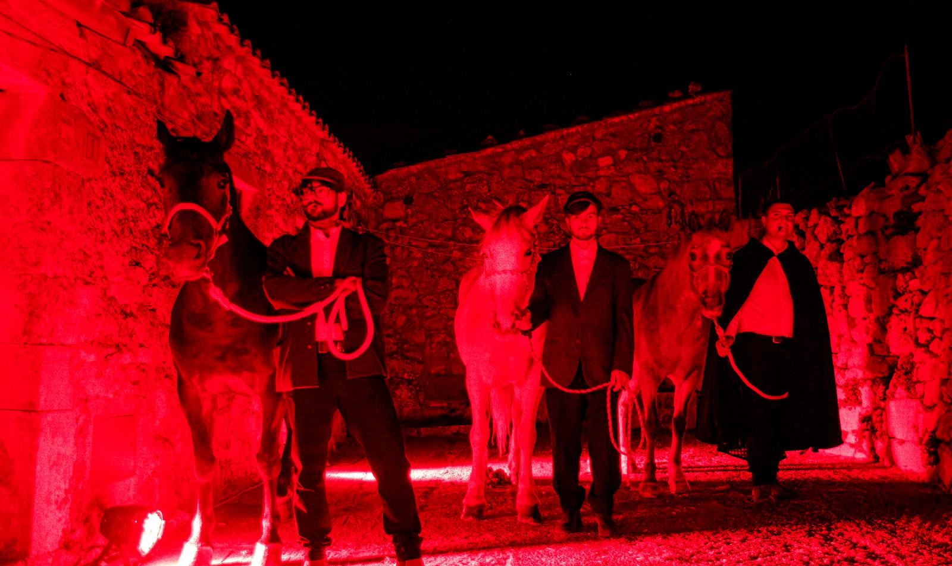
iART: Grand Events in Mediterranean Villages — tourism enhancement and destination attractiveness

Slide 5
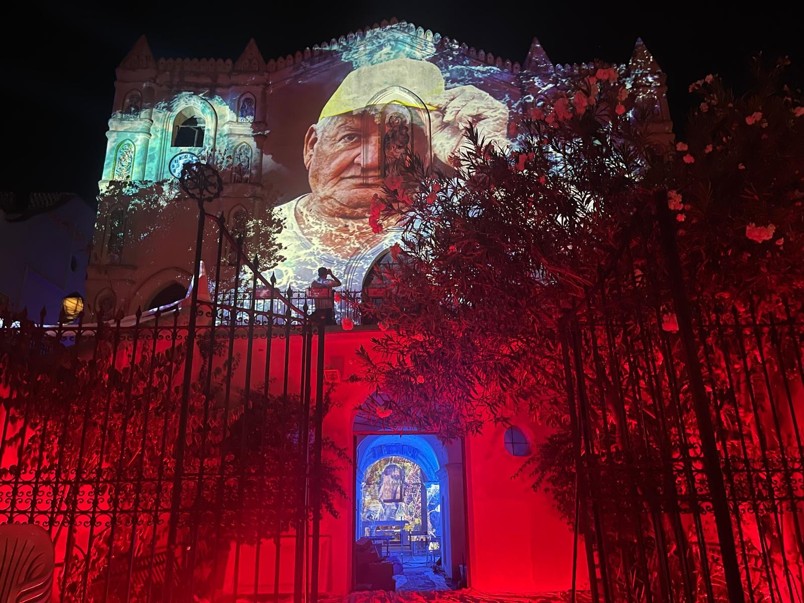
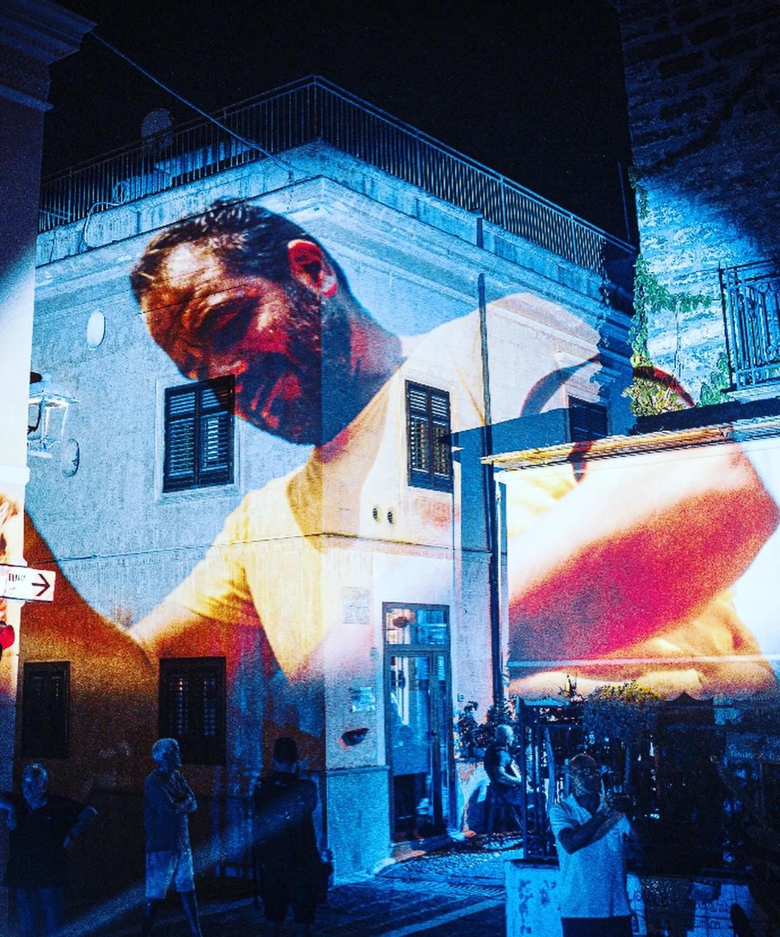
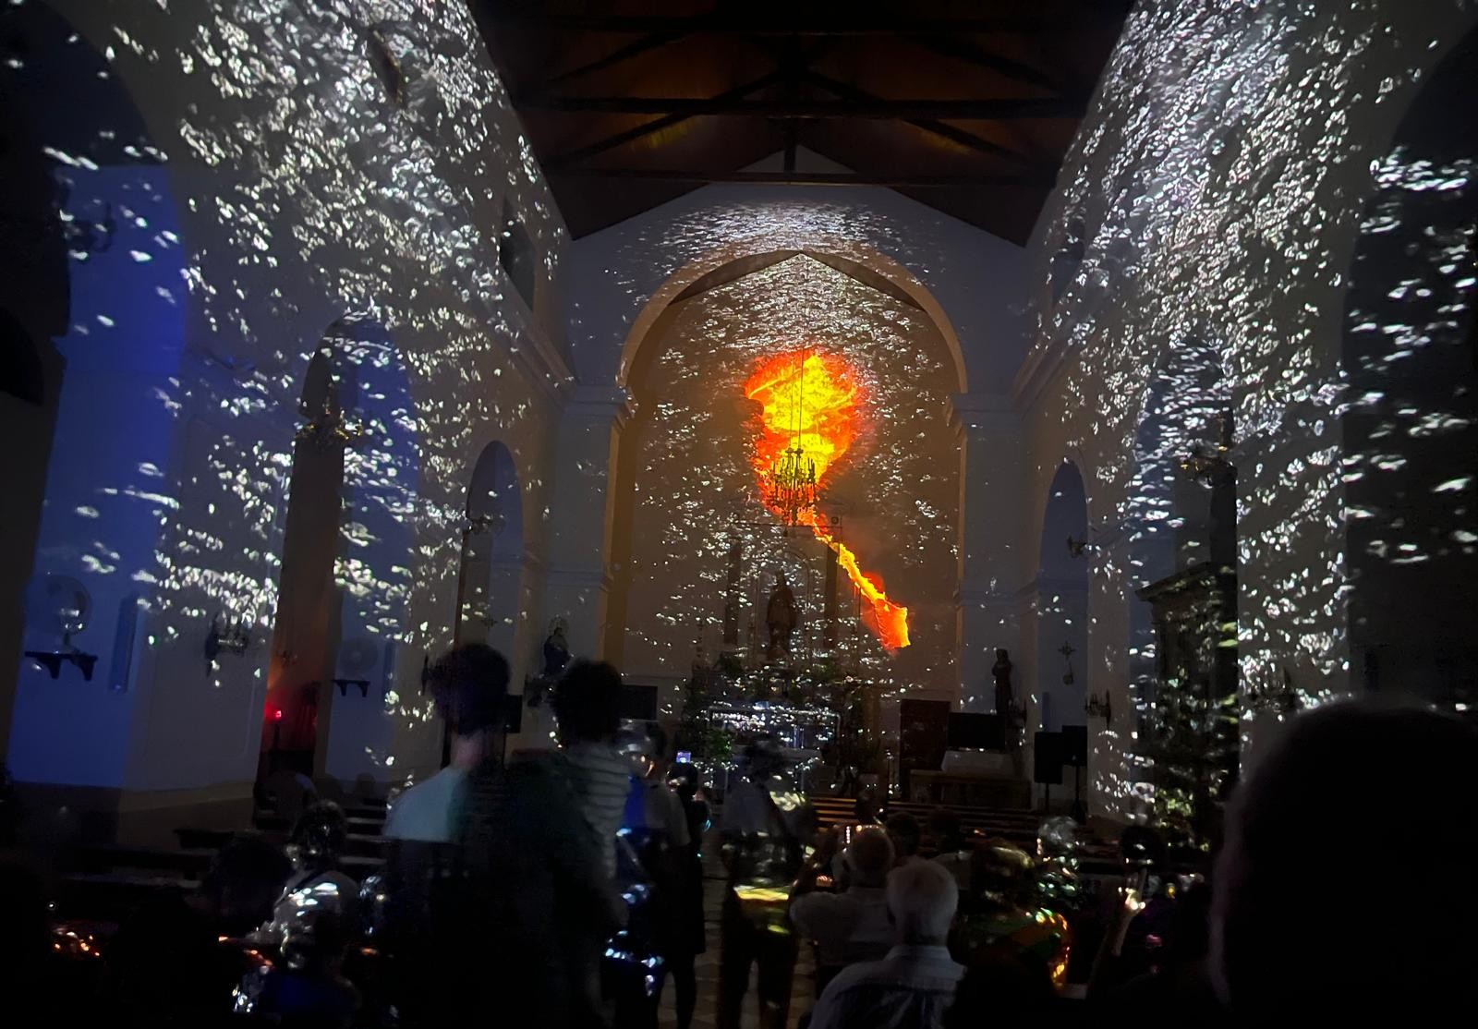
iART: Grand Events in Mediterranean Villages — tourism enhancement and destination attractiveness

Slide 6
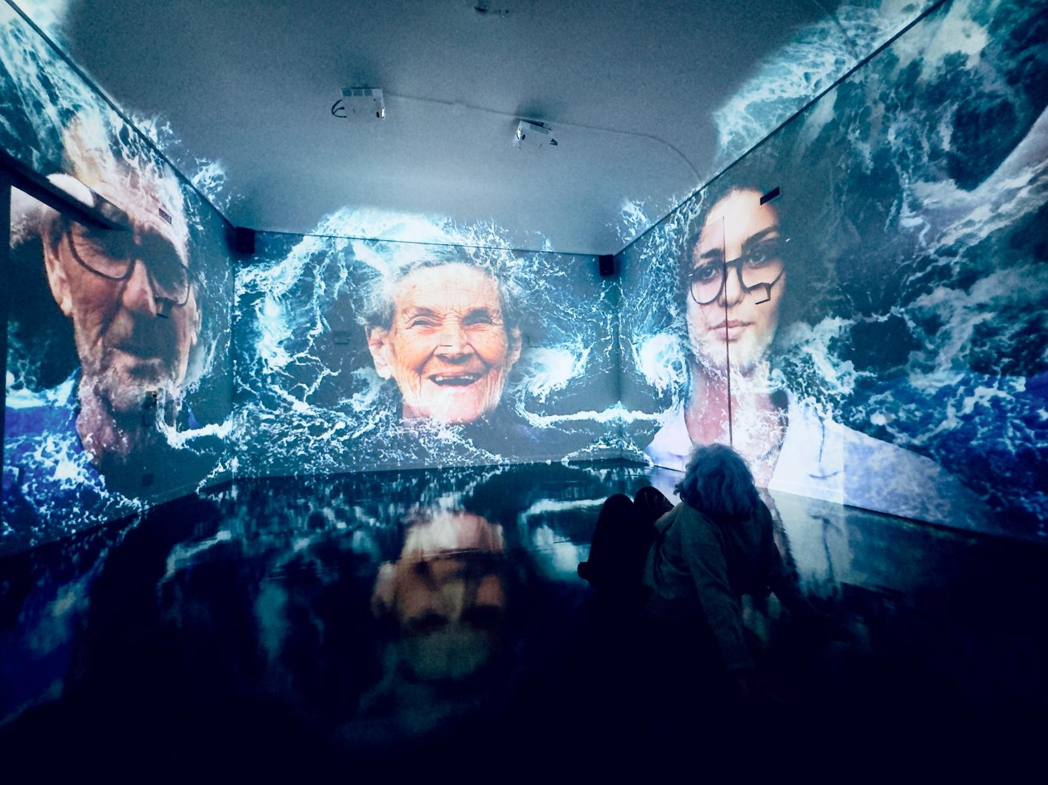

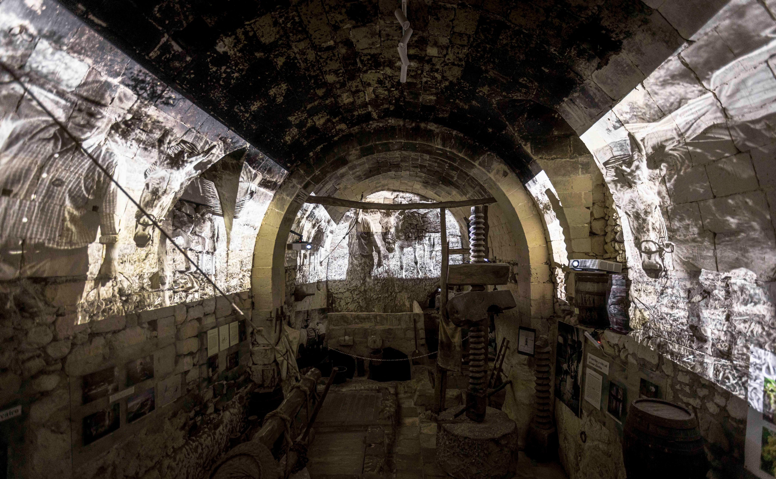
iART: Grand Events in Mediterranean Villages — tourism enhancement and destination attractiveness

Slide 7
Key Success Factors: iART — The Replicable Model
What 20 years of iART projects teach about event-driven transformation for small Mediterranean destinations
01
02
03
04
05
Authenticity
Over Scale
Co-creation
With Community
Artist as
Territorial Ambassador
Permanence
Of the Work
Digital Extension
Of the Physical
The event must be rooted in the specific identity of the place — its traditions, landscape, stories.
Identity-based events generate attachment, return visits, word-of-mouth, and media resonance that no advertising budget can buy.
Local artisans, schools, associations and elders became protagonists, not spectators.
This transforms an event into a community asset — ensuring the legacy is social, not only physical.
International artists who work in a village become lifelong ambassadors.
Through their networks, exhibitions and social media, they carry the destination to audiences unreachable through conventional marketing.
A mural, a digital museum, a restored cultural centre — permanent presences that generate visits year-round.
The event is the catalyst; the artwork is the lasting infrastructure.
Virtual exhibitions, augmented reality and online platforms let small villages reach global audiences.
Art4Sea's virtual dimension creates a digital touchpoint that drives real destination interest.
« Major events that unlock the Mediterranean soul create something irreplaceable: a reason to choose this specific place, and no other. »

Slide 8




Thank you for your attention!
Feel free to contact me at:
lucenzius@gmail.com
www.iworld.network

