Slide 1

















CROISIÈRES, MOBILITÉS ET CONNECTIVITÉ TOURISTIQUE EN MÉDITERRANÉE
Jordi Torrent
Secretary General

Slide 2
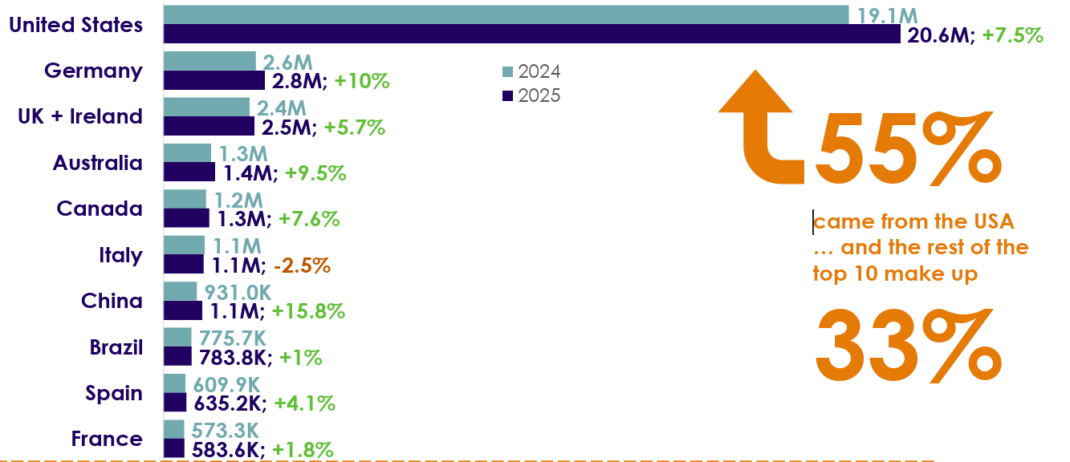

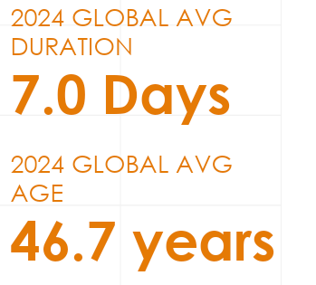
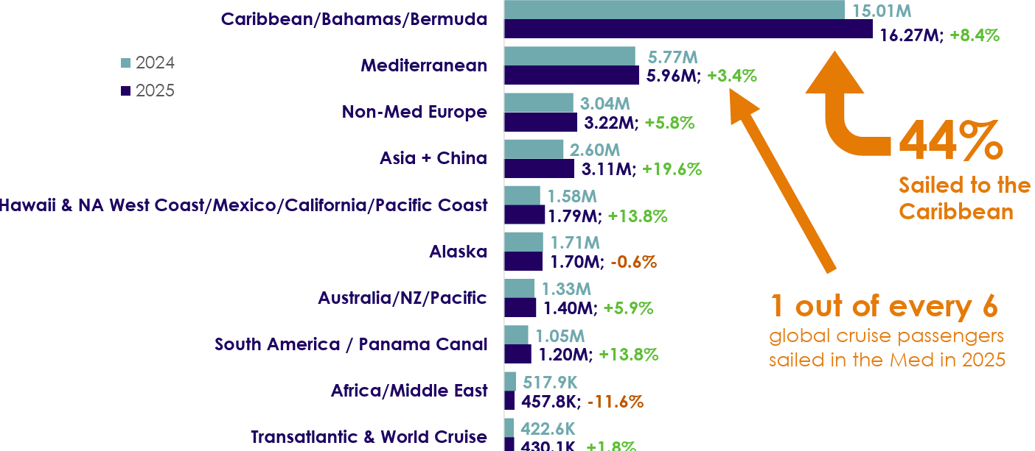
2025 Cruise industry Update
Global cruise passenger volume reached
a historic high of 37.2 million in 2025
Source: CLIA anual report 2025

Slide 3
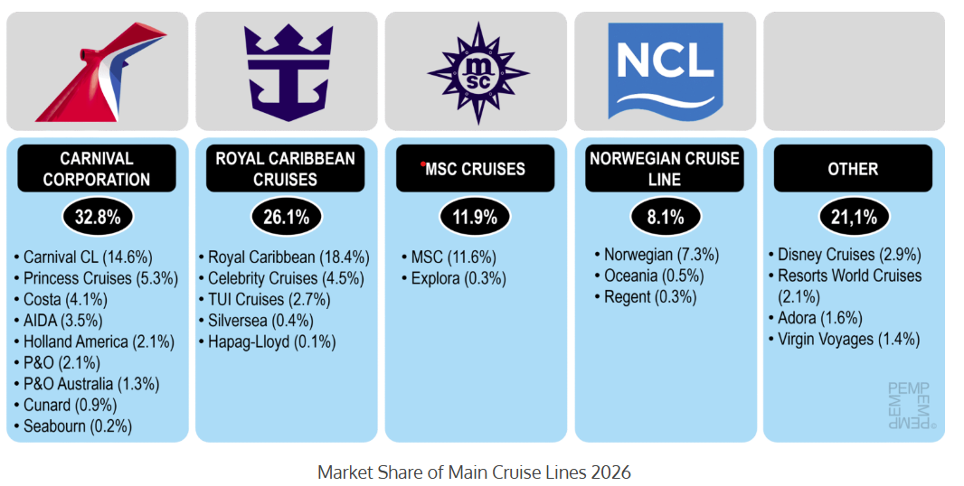
2025 Cruise industry Update
1. Port Canaveral (United States): 8.6 million passengers
2. Port Miami (United States): 8.5 million passengers
3. Port of Nassau (Bahamas): 6 million passengers
4. Port of Cozumel (Mexico): 4.7 million passengers
5. Port Everglades (United States): 4.7 million passengers
6 Port of Barcelona (Spain): 3.9 million passengers
7. Port of Civitavecchia (Italy): 3.7 million passengers
8. Port of Galveston (United States): 3.6 million passengers
9. Port of Southampton (United Kingdom 3 million passengers
10. Ports of the Balearic Islands (Spain): 2.5 million passengers
Source: Port economics

Slide 4




Bets practice in the MED: Port of Barcelona
Number of calls in 2025: 825
Average impact in Catalunya per call
Average impact in Barcelona per call
0,9 M€
GDP
0,4 M€
Rentas salariales
11,9
Ocupados
(10,6 ETC)
1,1 M€
Facturación
0,6 M€
GDP
0,3 M€
Rentas salariales
8,4
Ocupados
(7,6 ETC)

Slide 5
Bets practice in the MED: Port of Barcelona
IMPACT
More than 9,000 full time jobs
(50% non touristic)
Intercontinental direct air connectivity
Taxes revenues
Diversification of port activity
Shipping lines cargo & passenger
synergies
…
TRENDS
City pressure
Decarbonisation (OPS
Reduction pollution (LNG)
Turnaround
Longer season
Bigger vessels
Diversification of excursions
…

Slide 6



Merci pour votre attention!
Conctactez moi sur :
jordi.torrent@medports.net
medports.net

